Slide 1

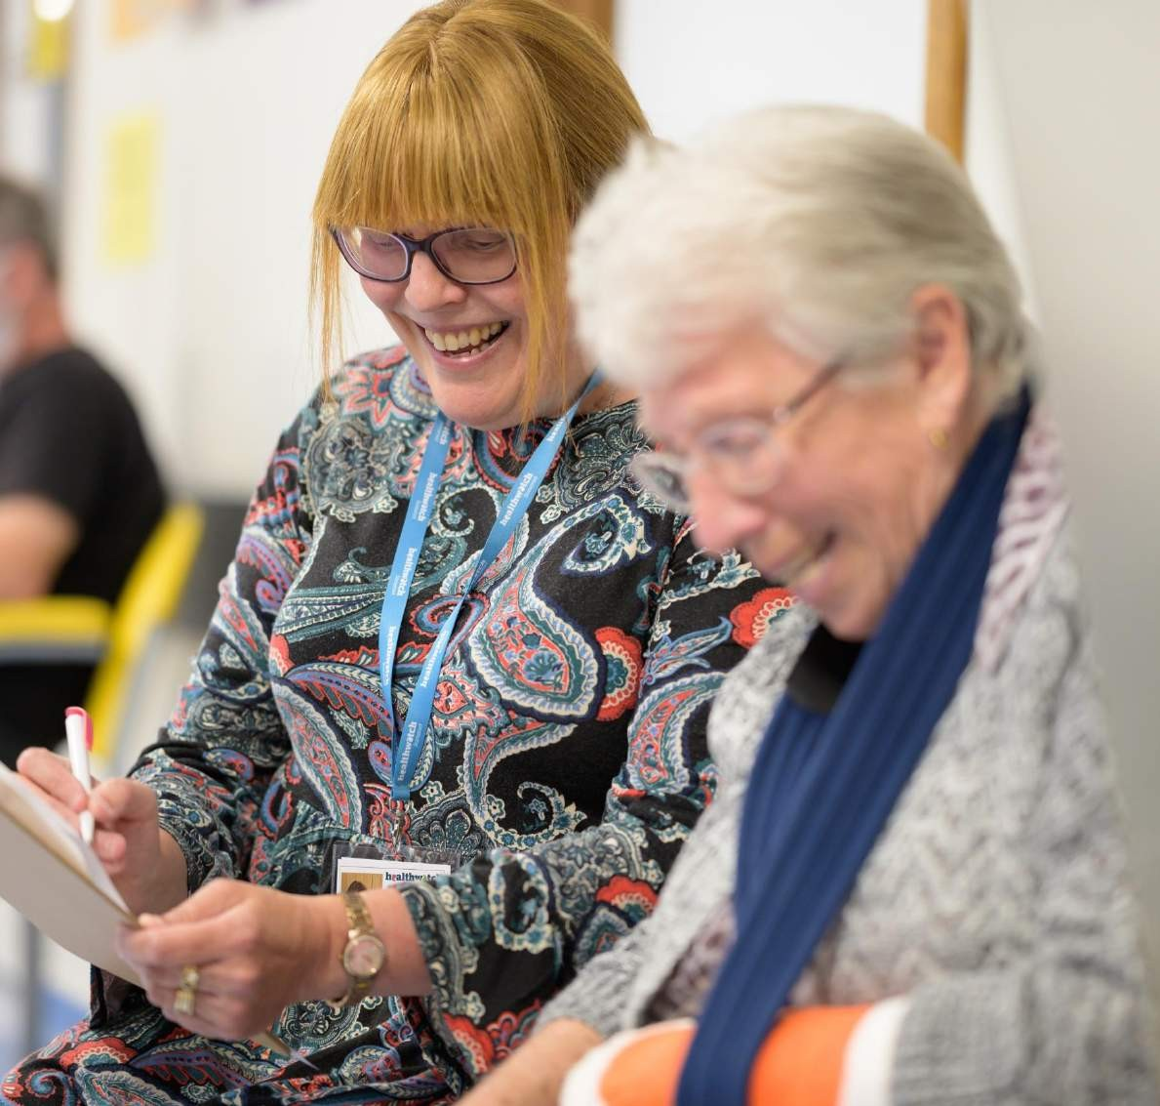
Together
We are making health
and social care better
Annual Report 2022/2023

Slide 2
Contents
Message from our team 3
About us 4
Highlights from our year 6
Listening to your experiences 9 Hearing from all communities 13
Advice and information 18
Volunteering 21
Finances and future priorities 24
Statutory statements 25
"In the last ten years, the health and social care landscape has changed dramatically, but the dedication of local Healthwatch hasn't. Your local Healthwatch has worked tirelessly to make sure the views of local people are heard, and NHS and social care leaders use your feedback to make care better."
Louise Ansari, Healthwatch National Director

Slide 3


Message from our Team
Introduction:
2022/2023 has been an eventful year for the Healthwatch Newham Team as the borough started to pick itself up after the COVID pandemic.
As a team, we were sorry to say goodbye to several staff, including our Healthwatch Manager and team members who initially joined as volunteers. However, we have successfully recruited to those roles, and the Team is back working at full strength.
We have continued to raise questions about the health inequalities that Newham residents face and are closely involved in working with decision-makers, commissioners and providers on improving facing and have been closely involved in working with decision-makers, commissioners and providers to improve health and care outcomes for all, including the Newham Health and Care Partnership and Newham Council.
We have endeavoured to act on resident and patient feedback with our work on maternity services and hospital discharge. Our ‘lunch and learn’ seminars have enabled us to inform residents about difficult and inaccessible topics.
We have been delighted to launch our Young Healthwatch programme, our Community Listening Ears engagement tool. We are working with residents and community organisations to agree on increasing community understanding of safeguarding.
Our Annual Report summarises the highlights of our work.
  I am delighted that our 2022-2023 Annual Report from Healthwatch Newham shows how we have taken residents’ experiences and used them to inform and influence the delivery of local services.
  Cllr Ann Easter:
  Co-Chair Healthwatch Newham Advisory Board

Slide 4



About us
Healthwatch Newham is your local health and social care champion.
We ensure NHS leaders and decision-makers hear your voice and use your feedback to improve care. We can also help you to find reliable and trustworthy information and advice.
Our vision
A thriving and active community of Newham people who influence and contribute to developing and delivering quality health and social care in the borough.
Our mission
To empower Newham residents to have a say in their health and care and to work with partners to improve the quality of health and care services in the borough.
Our ambitions include:
Having a powerful relationship with residents, volunteers and service users to gather their views and experiences, capturing and presenting the voices of under-represented communities
Promoting and supporting the involvement of people in the monitoring, commissioning and provision of local care services
Signposting individuals to available advice and information to help them make informed choices about their health and social care

Slide 5



Year in review
Reaching out
1,500 people
shared their experiences of health and social care services with us, helping to raise awareness of issues and improve care.
13,437 people
came to us for straightforward advice and information about mental health and the cost-of-living crisis, for example.
Making a difference in care - We published
8 reports
about the improvements people would like to see in health and social care services.
Our most popular report was
Newham Hospital Discharge Project Report,
which highlighted the struggles people face on discharge
Health and care that works for you
15
We are lucky to have
outstanding volunteers who gave up 45 days to make care better for our community.
Our local authority funds us. In 2022-23, as per the we received
£165,000
Which is the same as the previous year.
We currently employ
2.6 staff,
who help us carry out our work.

Slide 6




How we’ve made
a difference this year
Spring
Surveying maternity choices of Newham women
Reviewing the support provided to care homes by primary care following Covid
Summer
Working with NEL Healthwatch to gather views of people using ambulance services
Established Young Healthwatch to gather the views of young people’s experiences of health and care services
Autumn
Teaming up with the British Red Cross, we called for improvements to make leaving hospital safer during the pandemic
We urged the Government to act after reporting that residents are continuing to struggle to see an NHS dentist.
Winter
We arranged for the GP Federation to present details of their out-of-hours and Extended Access Service to Health Scrutiny to inform residents of these services.
Through our membership of the Health Equity Board, we encourage decision-makers to deliver programmes that reduce health inequalities as part of their delivery.

Slide 7


10 years of improving care
This year marks a special milestone for Healthwatch. Over the last ten years, people have shared their experiences, good and bad, to help improve health and social care. A big thank you to all our Healthwatch Heroes who have stepped up and inspired change. Here are a few of our highlights:
How have we made care better together?
Vaccine confidence
Our research exploring vaccine confidence with people from different backgrounds provided vital lessons for public health
campaigns.
NHS admin
We highlighted the negative impact poor NHS admin can have and recommended five principles for services to improve people’s experiences.
Patient transport
NHS England announced improvements to non-emergency patient transport services thanks to public feedback.
Waiting list support
After we and other organisations called for an urgent response to hospital waiting lists and better interim communication and support, the NHS set out a recovery plan to address the backlog.
NHS dentistry
We continued to voice public concerns that improvements to NHS dentistry are too slow, leaving thousands of
people in pain.

Slide 8
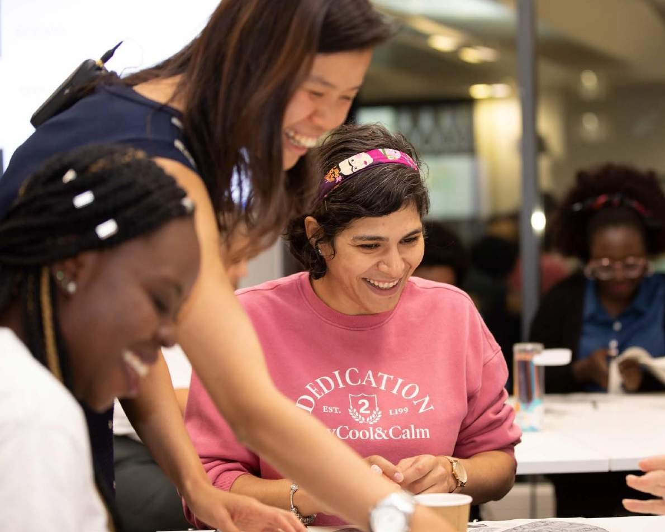

Healthwatch Hero
Celebrating a hero in our local community.
Mr. P is one of our Healthwatch Newham Heroes. He told us that he had been a patient at Newham Hospital and had been discharged from the hospital at 10:00 p.m.
The hospital had been unable to arrange any transport for him. Dazed, confused, and still unwell from his hospital stay, he slept overnight at a bus stop.
He was discovered the following day by kind passers-by and taken to his home. His family contacted Healthwatch Newham, expressing distress at his treatment. We were surprised and contacted Newham Hospital, reporting it as a safeguarding concern.
They asked the team to investigate their discharge processes independently.
Thank you, Mr. P and your family, for sharing your story to help create positive change for everyone who accesses the hospital.
We are now confident that Newham Hospital will endeavour to ensure this will never happen again to one of their patients.

Slide 9
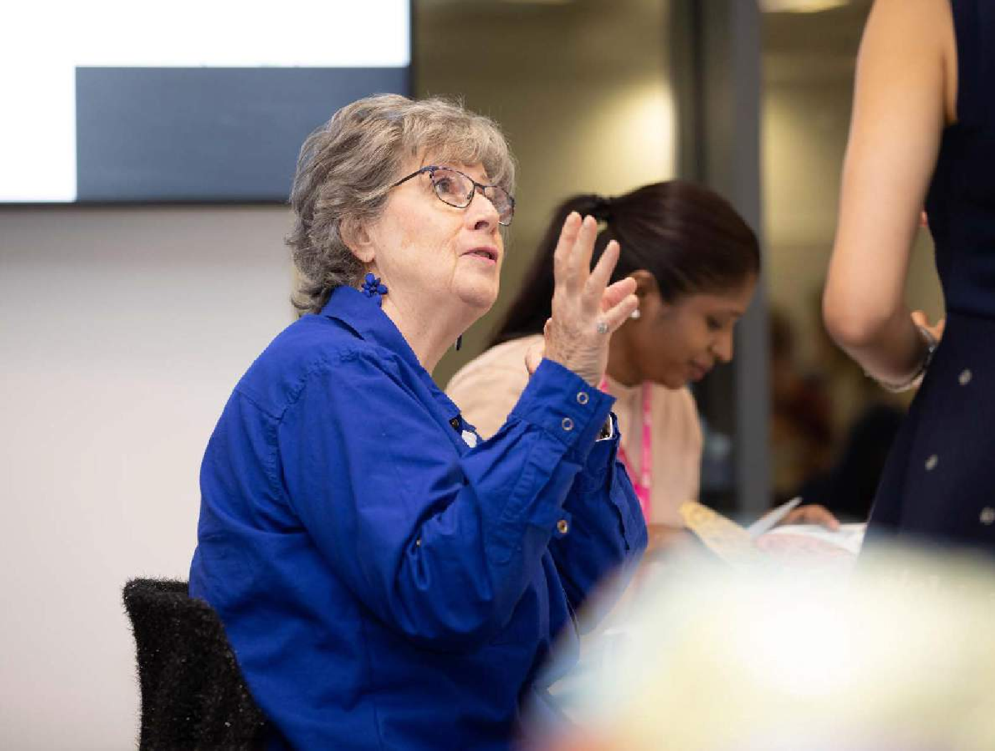
Listening to your experiences
Services can’t make improvements without hearing your views. That’s why we have prioritised listening to feedback from all areas of the community over the last year. This allows us to understand the complete picture, feed this back to services and help them improve.

Slide 10

Hospital Discharge – what is the experience for patients
Following the report of a patient discharged from Newham Hospital at 2200 hours without hospital transport, Healthwatch Newham worked with Newham Hospital to gather information from patients discharged from the Acute Assessment Unit (AAC).
NHS hospitals are responsible for ensuring patients' safe and efficient discharge.
Every patient should be actively included in the discharge process, and if the patient consents, their family or caregivers should also be given the chance to participate.
What did we find?
Speaking to 91 patients, we found that they wanted:
To be more involved in understanding discharge processes
Wanted to have more information and signposting about their diagnosis and treatment
That the vast majority were satisfied with their care.
Medicine dispensation could be contributing to delays in discharge.
What did we recommend?
All patients should be involved and informed of their care plan, including any services they anticipate receiving, including treatments that the hospital may not offer.
As a result, they are reviewing their discharge process to ensure a more precise alignment between the discharge and the medicines required.
I did not expect anything to happen, but I was called later to say that I have a follow-up appointment and will be attending that next week. Thank you, Healthwatch Newham.
Patient from Newham Hospital

Slide 11

Community Listening Ears
This year, we launched our Community Listening Ears (CLE) as a grassroots-led community engagement project. Our volunteers inspired us to enrich Healthwatch's engagement with residents.
On 25th August 2022, during our ‘Volunteers Drive’ event, volunteers recommended a deep dive into residents’ experiences of managing their mental health post-COVID, alongside the compounded economic effect of the cost-of-living crisis.
What did we want to do?:
We wanted to gather residents’ voices about their mental health experiences in three areas: Relationships, Long-Term Conditions, and cost of living. The goals of this project were to:
Explore how mental health impacted the relationships of Newham residents since the start of the pandemic.
. Understand how long-term conditions affect residents’ mental health and understand which ways they support themselves.
. Investigate how the rising cost of living impacted Newham residents’ mental health
What difference will this make?
What we were able to do was to recruit volunteers who looked and sounded like Newham residents. We believe that many people do not always share the ‘full picture’ of their experiences because they do not think that the impact of their cultural, linguistic or faith values is included in an analysis of their experiences.
Our Community Listeners were aligned to focus groups reflecting themselves. This enabled our residents to speak freely and without fear.
We will be replicating this model during 2023/2024.
Social services stigmatise mothers. We are scared to use them as we fear they take our children away. That’s why we keep to ourselves and not reveal our mental health.
– Somali woman speaking with Healthwatch volunteers.

Slide 12

Three ways we have made a difference for the community
Throughout our work, we gather information about health inequalities by speaking to people whose experiences aren’t often heard.
Creating empathy by bringing experiences to life
The summer of 2020 was sweltering. Working with the British Red Cross, we ran several campaigns encouraging people to look after themselves and others. We shared the Heatwave Checklist and First Aid Advice. We cascaded the information in different languages through our community links to our diverse communities.
We gathered the views of residents about the relevance of the language and fed this back to both the NHS and the British Red Cross,
This learning will inform public health messages about heat management in future public health campaigns.
Getting services to involve the public
Services need to understand the benefits of involving local people to help improve care for everyone.
We were delighted to start delivering our series of ‘Lunch and Learn’ Seminars to residents, stakeholders and service providers. Our first event covered mental health and Newham’s services, including the Talking Therapy Service and the Suicide Prevention Strategy. Service users were encouraged to join, listen and share their stories.
Improving care over time
Change takes time. We often work behind the scenes with services to consistently raise issues and bring about change.
Working through the NHS NEL, we gathered insight into Direct Enhanced Service provided to Care Home residents using our Community Insights System data. The response across NEL showed that the service was not implemented consistently across the NEL, raising questions on how well vulnerable care residents are looked after.

Slide 13
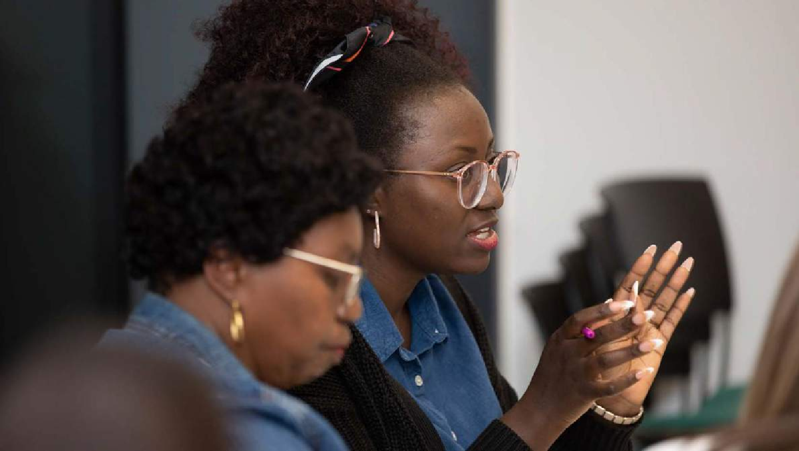


Hearing from
all communities
Over the past year, we have worked hard to ensure we hear from everyone in our local area. It is essential to reach out to the communities we hear from less frequently to gather their feedback and ensure their voice is heard and services meet their needs.
This year, we have reached different communities by:
Speaking directly with Somali women about their experiences of maternity services
Listening to residents using food banks to collect food to feed their children
Using our community insight to provide feedback on patient experience of accessing GP appointments

Slide 14
Understanding how the maternity experience informs choice
North East London Local Maternity and Neonatal Service commissioned Healthwatch Partners to understand the demand for and nature of culturally sensitive Maternity care provision within NEL and the reasons for the choice of Maternity Unit to evidence any contributing factors following the development of the Maternity Equity and Equality Action plan 2022 and concern about the ongoing division in maternity experience relating to health inequality. We heard from 403 women.
North East London has the highest birth rate in the UK and a prediction of growth in population to 270,000 in the next 20 years. As the most diverse ICS in the country, with 53% of the population identifying as Black, Asian or from a global majority, compared to 11% across England overall. 73% of babies born in NEL in 2020/21 are from the two most deprived quintiles.
What we found:
Referral by GP seems to lead to less choice and co-production experienced by maternity service users than self-referral mechanisms.
Service users from Black African, Turkish, Pakistani and Eastern European communities are less likely to experience a choice of maternity unit.
Fluency in English is a well-known marker of inequality, and we see this here.
Being a single parent, although now less stigmatised, remains a marker of inequality.
Respondents of Black ethnicities experience a double barrier to maternity care. because they are more likely to value cultural symmetry but less likely to share this.
Polish and Pakistani respondents were less likely to report having access to professionals who speak their language.
Antenatal classes have suffered a pandemic impact. They are no longer widely available for free at the point of access, which might negatively impact service users facing inequality.
Antenatal provision is sometimes perceived to be rushed and lacking engagement from Maternity Health professionals.
Cultural Sensitivity
For some communities, the gender of their Maternity Health Professional and the provision of culturally sensitive maternity care was significant. For other communities, this was less important.

Slide 15
Most respondents had positive feedback on their antenatal experience and felt listened to by midwives; however, inequalities correlating with ethnicity, social class and disability may be affecting a small but distinct population of NEL Maternity service users:

Slide 16
Recommendations
• Creating greater awareness of the nature of health inequality across North East London.
• Further research into GP referral structures.
• Further research into self-referral choice mechanisms.
• Management of capacity issues within antenatal provision.
• Clear information about antenatal waiting times and the impact of delayed arrival.
• Training for staff in engagement and empathy (and trauma-informed care, particularly for previous baby loss as with the previous equity and equality recommendations).
• Cultural sensitivity training for Maternity staff caring for service users from Black, Polish and Pakistani communities.
• Interpreting services for any service user with less than conversational English.
• Improved parking facilities where a car is the primary mode of transport.

Slide 17
Reducing the isolation of the Deaf/Hard of Hearing Communities
Healthwatch Newham is working closely with Newham Health and Care Partnership, Newham Deaf Forum and Deaf presented to our Advisory Board on the work. We are working in partnership to raise the profile of the community, which we hope will be realised in 2023/2024.
Presenting the resident experience with dental services
Healthwatch Newham summarised our work on dentistry to the Health Overview and Scrutiny Committee in March 2023.
Between 2017 – 2020, Healthwatch Newham (HWN) conducted several deep-dive reports into resident experiences using all 29 dentists in the borough. Residents have repeatedly reported difficulty accessing both emergency and general NHS dentist appointments. All reports have emphasised the need to review the allocation of NHS dentist appointments in Newham to address current availability constraints.
Despite dental commissioning moving to local ICBs, we are concerned that the current system will still disadvantage Newham residents.
Residents’ Experience of Using London Ambulance Service
Healthwatch within London were invited to shape the 2023 – 28 organisation strategy for the London Ambulance Service (LAS) in November 2022. We partnered with the Healthwatch North East London (HW NEL).
We engaged with 75 Newham residents and made a number of recommendations which we hope will be incorporated into the LAS 5-year strategy.

Slide 18
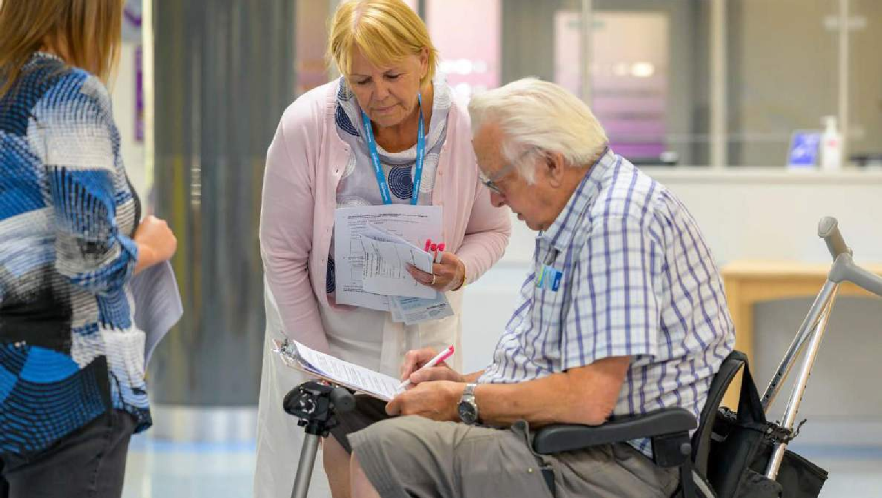
Advice and information
If you feel lost and don’t know where to turn, Healthwatch is here for you. In times of worry or stress, we can provide confidential support and accessible information to help you understand your options and get the help you need. Whether it’s finding an NHS dentist, how to make a complaint or choosing a good care home for a loved one – you can count on us.
This year, we’ve helped people by:
Providing up-to-date information people can trust
Helping people access the services they need
Helping people access NHS dentistry
Supporting people to look after their health during the cost–of–living crisis
Healthwatch Newham Annual Report 2022/23

Slide 19
Advice and Information Service
Healthwatch Newham Website Resources
Visit www.healthwatchnewham.co.uk to see our up-to-date resources, including updates on GP, hospital and social care providers, support and guidance on COVID-19, specific information for high-risk groups and details of support available locally, shopping and prescription deliveries to look for after one’s physical and mental health whilst in isolation. We review and update all our resources regularly.
We help residents find their required health and social care by providing details and signposting people to relevant services. To learn more, visit our resources and directory pages at healthwatchnewham.co.uk/resources-1 and healthwatchnewham.co.uk/directory.
Call us on 020 3866 2969 for any health and social care questions.
Complex cases and safeguarding
Occasionally, residents, patients or their relatives need help accessing services and support or feel lost or not listened to by service providers. They refer to Healthwatch for signposting and support.
Healthwatch Newham Annual Report 2022/23

Slide 20
NHS Complaints Advocacy
Our Advocacy Service helps residents, particularly those who are vulnerable or need additional support, to raise a complaint if they are unhappy with the care or treatment they or someone they know has received from the NHS.
During the year, the service received 1005 calls and supported 368 residents with more than 300 issues, working with a wide range of communities in Newham, reflecting the diverse local population.
The service has:
Helped improve the response time for complaints by continuing to meet with the Barts and Newham Hospital Complaints Team.
Alerted Newham Hospital with a serious discharge error.
The Advocacy Service is delivered in partnership with Mind in Tower Hamlets and Newham, which has achieved the ‘Quality Performance Mark’ for advocacy quality standards.
For more information and advice, please get in touch with the NHS Complaints Advocate for Newham:
advocacy@healthwatchnewham.co.uk
020 3828 8245 or visit healthwatchnewham.co.uk/advocacy
Complex cases and safeguarding
We received a query from a distressed resident about their mental health condition and the support they felt they were not receiving. We referred the case to the Safeguarding Adults team, who took up the case to identify the issue and follow up with the resident.
Healthwatch Newham Annual Report 2022/23

Slide 21
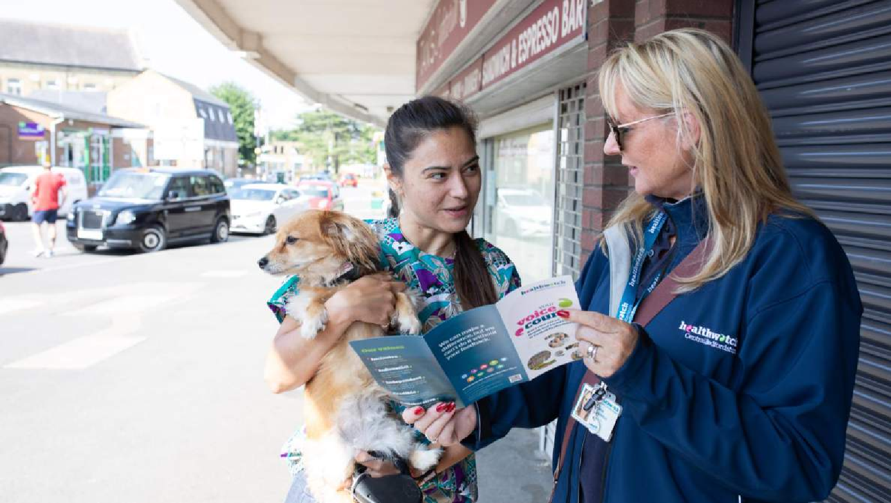
Volunteering
We’re supported by a team of amazing volunteers at the heart of what we do. Thanks to their community efforts, we can understand what is working and needs improvement.
This year, our volunteers:
Visited communities to promote their local Healthwatch and what we have to offer
Collected experiences and supported their communities to share their views
Carried out enter and view visits to local services to help them improve
Reviewed GP and dentist websites to review accessibility
Collected the most up-to-date information on changes to services, such as whether NHS dental appointments were available at a practice

Slide 22

Do you feel inspired?
  We are always on the lookout for new volunteers, so please get in touch today.
Healthwatch Newham Annual Report 2022/23

Slide 23


Estelle
I became an Interview and Engagement Intern at Healthwatch Newham in March 2023 whilst wrapping up my BSc Public Health Degree. The experience I gained through this internship about community engagement through the Enter and View project has been invaluable. My passion lies within social justice, and I believe that the conditions in which people are born should not define them. I want to be able to advocate for the marginalised in the community by ensuring that health services are available to all whilst empowering the most vulnerable individuals in our society to access the services on offer.
Safiya
I'm Safiya, an Interview and Engagement Intern at Healthwatch Newham. I'm studying for a BSc in Public Health and can't wait to see where this field will take me. Public Health is like an octopus – it's everywhere! I've gained fantastic experience in community engagement and the Enter and View project. I'm passionate about social justice and believe that everyone deserves healthcare. I want to advocate for marginalised communities and help the most vulnerable people access their needed services.
Do you feel inspired?
We are always on the lookout for new volunteers, so please get in touch today.
https://www.healthwatchnewham.co.uk/
020 3866 2969
nicole.bello@healthwatchnewham.co.uk

Slide 24
Finance and future priorities
To help us carry out our work we receive funding from our local authority under the Health and Social Care Act 2012.
Our income and expenditure
Income |  |  | Expenditure
Annual grant from Government | £165,000 |  | Expenditure on pay | £ 86,345
Additional income | £3,974 |  | Non-pay expenditure | £ 58,916
 |  |  | Office and management | £15,100
Total income | £168,974 |  | Total expenditure | £ 160,361
Additional income is broken down into:
£3,974 received from Healthwatch Redbridge to assist with a project
Next Steps
In the ten years since Healthwatch was launched, we’ve demonstrated the power of public feedback in helping the health and care system understand what is working, identify issues and think about how things can be better in the future.
Services are currently facing unprecedented challenges, and tackling the backlog needs to be a key priority for the NHS to ensure everyone gets the care they need. Over the next year, we will continue collecting feedback from everyone in our local community and giving them a voice to help shape service improvements.
We will also continue our work to tackle existing inequalities and reduce the barriers you face when accessing care, regardless of whether that is because of where you live, income or race.
Top three priorities for 2023-24
Tackling health inequalities through the Health Equity Board with a focus on cancer
Working with Newham Safeguarding Board to increase understanding of community safeguarding
Extending our Community Listening Ears programme into communities whose voices have not been heard so loudly

Slide 25
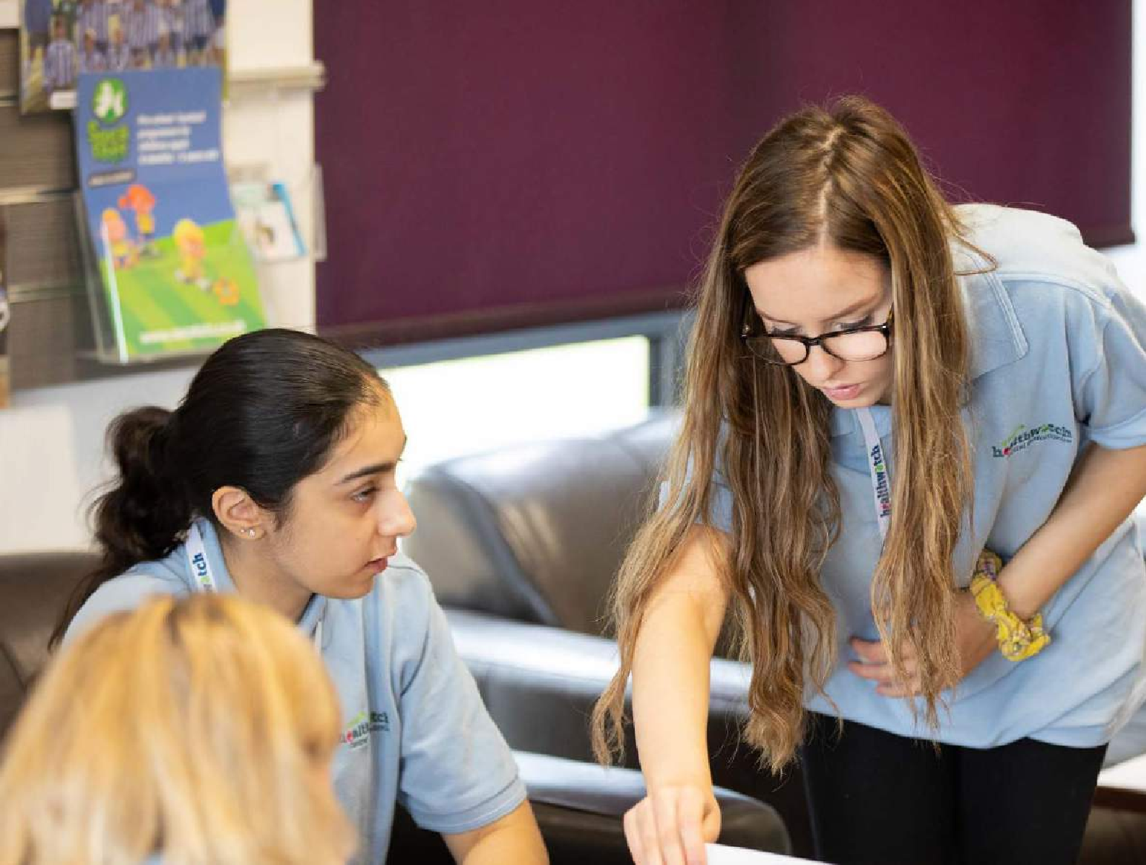
Statutory statements
Healthwatch England, 2 Redman Place, Stratford, E20 1JQ CommUNITY Barnet oversees the delivery of Healthwach Newham.
Mind in Tower Hamlets and Newham delivers the NHS Complaints and Advocacy Service.
Healthwatch Newham uses the Healthwatch Trademark when undertaking our statutory activities as covered by the licence agreement.

Slide 26
Healthwatch Newham is delivered in partnership with local organisations. We have established the Healthwatch Newham Advisory Board, whose role is to support the core team and shape the work programme around the needs of Newham residents.
Healthwatch Newham is leading one of the most significant charity partnerships in Newham. It works with Newham’s charity, voluntary and community organisations, and we would like to thank them for their guidance to Healthwatch Newham, particularly with some of Newham’s key communities:
Councillor Anne Easter (Co-Chair)
Julie Pal (Co-Chair) - CommUNITY Barnet /Healthwatch Newham
Leonardo Greco – Healthwatch Newham
Claire Helman, Chief Executive, Aston-Mansfield
Sandra Amoah – Co-chair Co-production Forum, Chair - ASK (User Led Mental Health Group)
Elif Huseyin – Caritas Anchor House
Zoraido Colorado – Community Links
Fiona Scaife – Mind in Tower Hamlets and Newham
Violet White - Older People’s Reference Group
Taskin Saleem – Subco Trust
Maria Abraham - West Ham United Foundation.
The Advisory Board’s membership is drawn from Newham-based organisation representatives. Its role is to support Healthwatch Newham to:
Identify critical areas of work
Develop and deliver activities
Provide guidance and support to project teams
Offer expertise, experience and knowledge which will promote and support Healthwatch Newham activities
26
Healthwatch Newham Annual Report 2022/23

Slide 27
The way we work
Involvement of volunteers and lay people in our governance and decision-making
Our Healthwatch Board consists of twenty members who work voluntarily to provide direction, oversight and scrutiny of our activities. Our Board ensures that decisions about priority work areas reflect the concerns and interests of our diverse local community. Throughout 2022/23, the Board met four times. It made decisions on matters such as establishing the Community Listening Ears Programme and consulted on the new NEL ICB Strategy.
We ensure wider public involvement in deciding our work priorities.
Methods and systems used across
the year to obtain people’s experiences
We use a wide range of approaches to ensure that as many people as possible have the opportunity to provide us with insight into their experience of using services. During 2022/23, we have been available by phone email, provided a web form on our website and through social media, as well as attending meetings of community groups and forums.
We ensure that this annual report is made available to as many members of the public and partner organisations as possible. We will publish it on our website:
https://www.healthwatchnewham.co.uk/.
Responses to recommendations
Four providers have yet to respond to requests for information or recommendations. We escalated no issues or suggestions to the Healthwatch England Committee, so there were no resulting reviews or investigations.
Taking people’s experiences to decision-makers
We ensure that people who can decide about services hear about the insights and experiences shared with us.
For example, we take information to Newham Health and Wellbeing Board and Health and Adult Care Scrutiny in our local authority area.
We also take insight and experiences to Newham Health and Care Partnership decision-makers. We are also part of the NEL Healthwatch group operating across NEL and have been commissioned by the NEL ICB to provide a community insights programme. We also share our data with Healthwatch England to help address health and care issues at a national level.
Healthwatch Newham Annual Report 2022/23

Slide 28
Enter and view
This year, we made five Enter and View visits. We made 23 recommendations or actions as a result of this activity. Our focus was primarily to visit smaller homes in the borough.
Location | Reason for visit | What you did as a result
Birchwood House – virtual visit | Advised by local authority | Wrote a report with recommendations
Ebenezer Care Home – Virtual visit | See how services were being delivered post-lockdown | Wrote a report with recommendations
Helena Road | To view post-lockdown activities | Wrote a report with recommendations
Manor Farm | Concerns about resident activities | Wrote a report with recommendations
Nicholas Court Care Home | See how services were being delivered post-lockdown | Wrote a report with recommendations
Healthwatch representatives
Healthwatch Newham is represented on the Newham Health and Wellbeing Board by Julie Pal CEO CommUNITY Barnet. During 2022/23 our representative has effectively carried out this role by attending meetings, presenting reports and participating in discussions on improving health and care outcomes for residents.
Healthwatch Newham is represented on Newham Health and Care Integrated Care Partnerships by Julie Pal.
2022–2023 Outcomes
Project/ activity | Changes made to services
Community Listening Ears | Providing a nuanced resident voice to service providers and decision makers
Maternity Choices | Demonstrating how Newham women make their maternity choices
Newham Hospital Discharge Project | Reviewed the Hospital Discharge Process with patients and staff
Healthwatch Newham Annual Report 2022/23

Slide 29

Healthwatch Newham
Stratford Advice Arcade
107-109 The Grove
London
E15 1HP
https://www.healthwatchnewham.co.uk/
t: 020 3866 2969
e: info@healthwatchnewham.co.uk
@HWNewham
https://www.facebook.com/healthwatchnewham/?locale=en_GBX

